Slide 1
VRify the Solar System
Patrick Abejar, Sammy Akharaz, Helen Liutongco, Angelina Wong

Slide 2
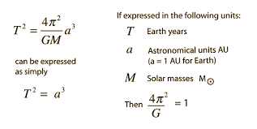
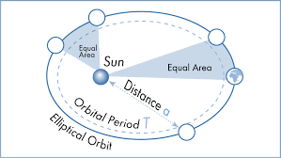
Our Challenge: Mixed Reality Solar System
The concept we wanted to demonstrate was Kepler’s Laws of Planetary Motion

Slide 3
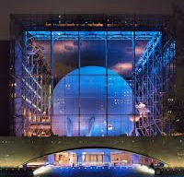

Our Approach
Building a lightweight, mobile responsive Virtual Reality where users could collaborate and build a solar system
Used Geolocation to isolate the use of the app to Hayden Planetarium
Allow multiple users to interact with the same VR environment
users can create planets with different distances from the Sun
each planet mirrors the speed of a rotation of a planet in our solar system

Slide 4
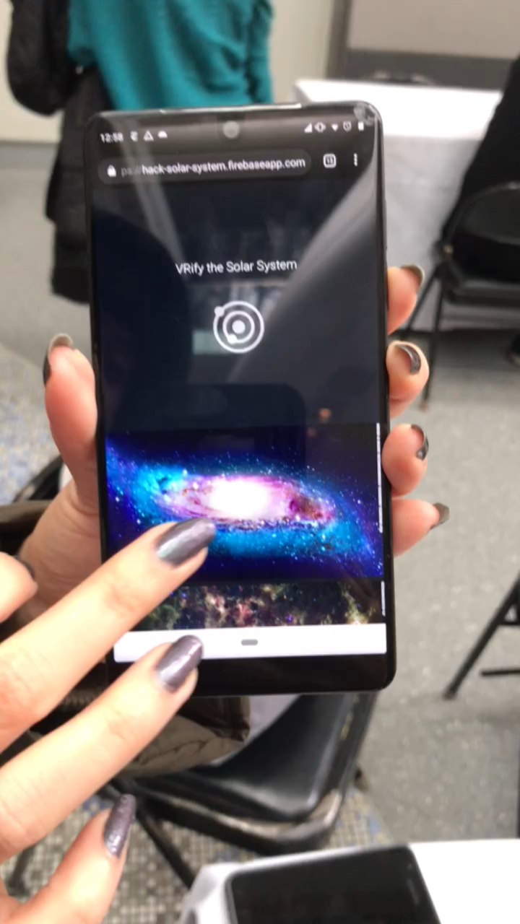
Demo
https://hack-solar-system.firebaseapp.com/

Slide 5
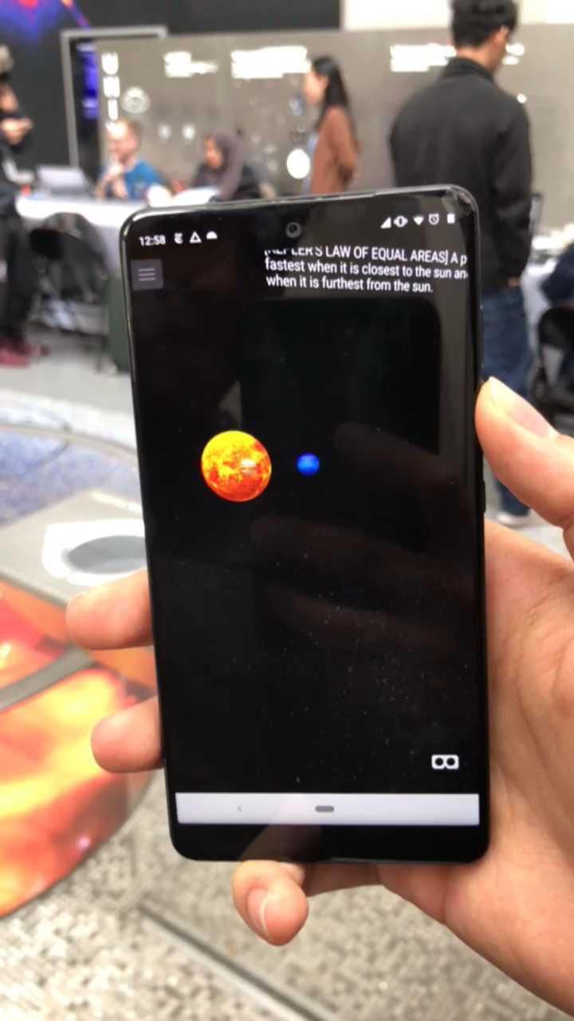
Demo
https://hack-solar-system.firebaseapp.com/

Slide 6
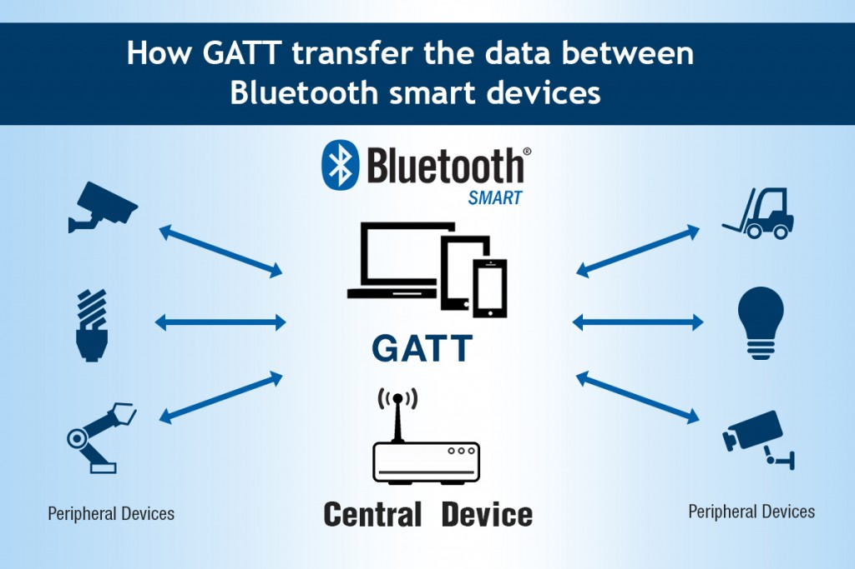
The Good
The Bad
Accomplished our MVP!
Made A-frame, React, and WebRTC to work together
Learned about Kepler’s Laws
Reached our main goal of having it be multi-user and interactive
Bluetooth

Slide 7
The Good
The Bad
Accomplished our MVP!
Made A-frame, React, and Web Sockets to work together
Learned about Kepler’s Laws
Reached our main goal of having it be multi-user and interactive
Bluetooth
???

Slide 8
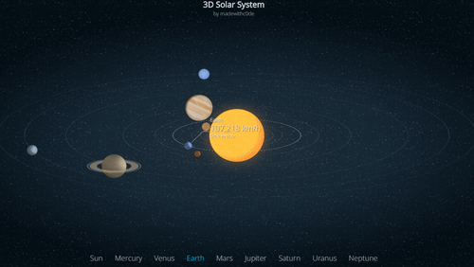
What’s Next?
Have the size of the planets impact the rotation and speed
More complete physics that allow for new planets to disrupt the orbits or destroy the Universe
Clickable planets with info
Realistic graphics
Moons
Dwarf Planets
Multiple Suns
To Infinity and Beyond!

